Slide 1

Natural Language Processing

Slide 2
Objectives
Introduction to NLP
Applications of NLP
Tokenization
Stemming & Lemmatization
Count Vector
TF IDF
Co occurrence Matrix
Bag of Words
Text Classification

Slide 3
What is Natural Language Processing?
The process of computer analysis of input provided in a human language (natural language), and conversion of this input into a useful form of representation.
The field of NLP is primarily concerned with getting computers to perform useful and interesting tasks with human languages.
The field of NLP is secondarily concerned with helping us come to a better understanding of human language.

Slide 4
Components of NLP
Natural Language Understanding
Mapping the given input in the natural language into a useful representation.
Different level of analysis required:
morphological analysis,
syntactic analysis,
semantic analysis,
discourse analysis, …
Natural Language Generation
Producing output in the natural language from some internal representation.
Different level of synthesis required:
deep planning
syntactic generation

Slide 5
Applications of NLP
Text/document classification
Social Media Text mining and Analysis
Speech to Text and Text to Speech conversion
Caption generation
Machine Translation
Sentiment analysis from text
Chatbots
Speaker recognition
Personal Assistant, Sentence Correction
Text Generation, Similarity Matching, Topic Modelling

Slide 6
Forms of Natural Language
The input/output of a NLP system can be:
written text
speech
To process written text, we need:
lexical, syntactic, semantic knowledge about the language
discourse information, real world knowledge
Language Processing
To process spoken language, we need everything required to process written text, plus the challenges of speech recognition and speech synthesis.

Slide 7
Why NL Understanding is hard?
Natural language is extremely rich in form and structure
One input can mean many different things. Ambiguity can be at different levels.
Many input can mean the same thing.
Interaction among components of the input is not clear.

Slide 8
Knowledge of Language
Phonology – concerns how words are related to the sounds that realize them.
Morphology – concerns how words are constructed from more basic meaning units called morphemes. A morpheme is the primitive unit of meaning in a language.
Syntax – concerns how can be put together to form correct sentences and determines what structural role each word plays in the sentence and what phrases are subparts of other phrases.
Semantics – concerns what words mean and how these meaning combine in sentences to form sentence meaning. The study of context-independent meaning.

Slide 9
Knowledge of Language
Pragmatics – concerns how sentences are used in different situations and how use affects the interpretation of the sentence.
Discourse – concerns how the immediately preceding sentences affect the interpretation of the next sentence. For example, interpreting pronouns and interpreting the temporal aspects of the information.
World Knowledge – includes general knowledge about the world. What each language user must know about the other’s beliefs and goals.

Slide 10
Simple Text Preprocessing

Slide 11
What exactly are regular expressions?
Strings with a special syntax
Allow us to match patterns in other strings
Applications of regular expressions:
Find all web links in a document
Parse email addresses, remove/replace unwanted characters

Slide 12
Why preprocess?
Helps make for better input data
When performing machine learning or other statistical methods
Examples:
Tokenization to create a bag of words
Lowercasing words
Lemmatization/Stemming
Shorten words to their root stems
Removing stop words, punctuation, or unwanted tokens
Good to experiment with different approaches

Slide 13
Preprocessing example
Input text: Cats, dogs and birds are common pets. So are fish.
Output tokens: cat, dog, bird, common, pet, fish

Slide 14
What is tokenization?
Turning a string or document into tokens (smaller chunks)
One step in preparing a text for NLP
Many different theories and rules
You can create your own rules using regular expressions
Some examples:
Breaking out words or sentences
Separating punctuation
Separating all hashtags in a twee

Slide 15
Why tokenize?
Easier to map part of speech
Matching common words
Removing unwanted tokens
"I don't like Sam's shoes."
"I“, "do“, "n’t”, "like“, "Sam", “’s”, "shoes", "."

Slide 16
Other nltk tokenizers
Tokenize
sent_tokenize: tokenize a document into sentences
Tokenize
regexp_tokenize: tokenize a string or document based on a regular expression pattern
Special
TweetTokenizer: special class just for tweet tokenization, allowing you to separate hashtags, mentions and lots of exclamation points!!!

Slide 17
Stemming
Stemming and Lemmatization are the basic text processing methods for English text. The goal of both stemming and lemmatization is to reduce inflectional forms and sometimes derivationally related forms of a word to a common base form.
The stem need not be identical to the morphological root of the word; it is usually sufficient that related words map to the same stem, even if this stem is not in itself a valid root.

Slide 18
Lemmatization
Lemmatisation (or lemmatization) in linguistics, is the process of grouping together the different inflected forms of a word so they can be analysed as a single item.
Lemmatisation is closely related to stemming. The difference is that a stemmer operates on a single word without knowledge of the context, and therefore cannot discriminate between words which have different meanings depending on part of speech. However, stemmers are typically easier to implement and run faster, and the reduced accuracy may not matter for some applications.

Slide 19
Part of Speech Tagging
Part-of-speech tagging is one of the most important text analysis tasks used to classify words into their part-of-speech and label them according the tagset which is a collection of tags used for the pos tagging.
Part-of-speech tagging also known as word classes or lexical categories.

Slide 20
Text Classification
Anshu Pandey

Slide 21
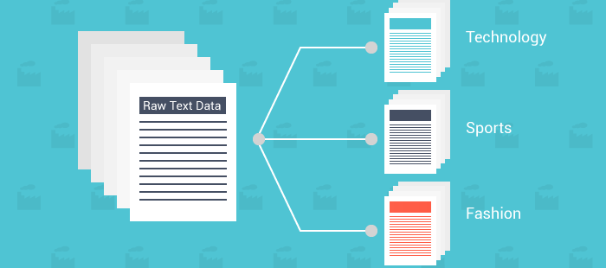
Text Classification Example

Slide 22
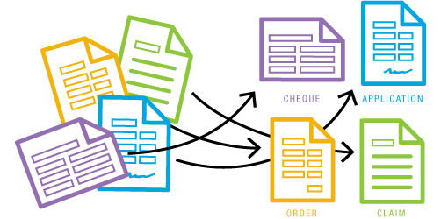
Text Classification Example

Slide 23
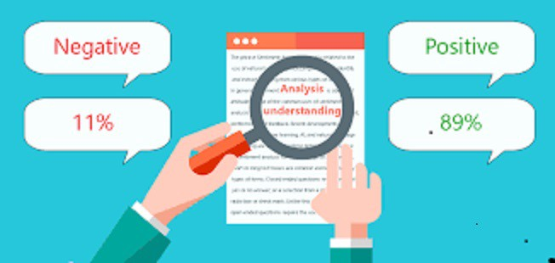
Text Classification Example

Slide 24
Text Classification Pipeline
Raw Text with Labels

Slide 25
Text Classification Pipeline
Raw Text with Labels
Text Cleaning

Slide 26
Text Classification Pipeline
Raw Text with Labels
Text Cleaning
ML Classification

Slide 27
Text Classification Pipeline
Raw Text with Labels
Text Cleaning
Vectorization
ML Classification

Slide 29
Different types of Word Vectorization
The different types of word embeddings can be broadly classified into two categories-
Frequency based Vectorization
Prediction based Vectorization

Slide 30
Frequency based Vectorization
There are generally three types of vectors that we encounter under this category.
Count Vector
TF-IDF Vector
Co-Occurrence Vector

Slide 31
Count Vector
Count vector
D1: He is a lazy boy. She is also lazy.
D2: Neeraj is a lazy person.
The dictionary created may be a list of unique tokens(words) in the corpus =[‘He’,’She’,’lazy’,’boy’,’Neeraj’,’person’]
Here, D=2, N=6
 | He | She | lazy | boy | Neeraj | person
D1 | 1 | 1 | 2 | 1 | 0 | 0
D2 | 0 | 0 | 1 | 0 | 1 | 1

Slide 32
What is tf-idf?
Term frequency - inverse document frequency
Allows you to determine the most important words in each document
Each corpus may have shared words beyond just stopwords
These words should be down-weighted in importance
Example from astronomy: "Sky"
Ensures most common words don't show up as key words
Keeps document specific frequent words weighted high

Slide 33
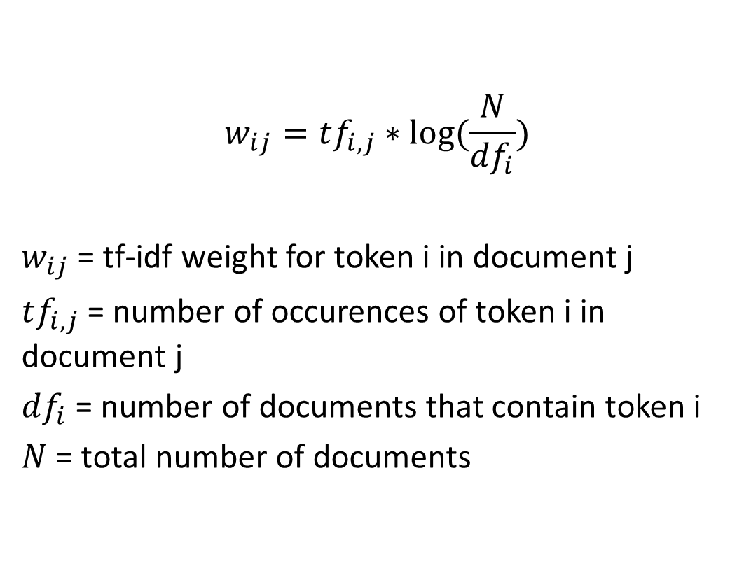
Tf-Idf Formula
$$w_{ij}=tf_{i,j}∗log⁡(\frac{N}{df_{i}})$$
$w_{ij}$ = tf-idf weight for token i in document j
$tf_{i,j}$ = number of occurences of token i in document j
$df_{i}$ = number of documents that contain token i
$N$ = total number of documents

Slide 34
Co-Occurrence Vector
Co-occurrence – For a given corpus, the co-occurrence of a pair of words say w1 and w2 is the number of times they have appeared together in a Context Window.
Context Window – Context window is specified by a number and the direction.

Slide 35
Co-Occurrence Vector
Corpus =
He is not lazy.
He is intelligent.
He is smart.
He is not intelligent
 | He | is | not | lazy | intelligent | smart
He | 0 | 4 | 2 | 1 | 2 | 1
is | 4 | 0 | 1 | 2 | 2 | 1
not | 2 | 1 | 0 | 1 | 0 | 0
lazy | 1 | 2 | 1 | 0 | 0 | 0
intelligent | 2 | 2 | 0 | 0 | 0 | 0
smart | 1 | 1 | 0 | 0 | 0 | 0

Slide 36
Bag-of-words
Basic method for finding topics in a text
Need to first create tokens using tokenization
... and then count up all the tokens
The more frequent a word, the more important it might be
Can be a great way to determine the significant words in a text

Slide 37
Text Classification
Text classification is one of the classical problem of NLP. Notorious examples include – Email Spam Identification, topic classification of news, sentiment classification and organization of web pages by search engines.
Text classification, in common words is defined as a technique to systematically classify a text object (document or sentence) in one of the fixed category. It is really helpful when the amount of data is too large, especially for organizing, information filtering, and storage purposes.

Slide 38

Summary
This module covered the following topics:
Introduction to NLP
Applications of NLP
Tokenization
Stemming
Lemmatization
Count Vector
TF IDF
Co occurrence Matrix
Bag of Words
Text Classification

